Slide 1
The impact of the economic downturn and policy changes on health inequalities in London
UCL Institute of Health Equity
www.instituteofhealthequity.org

Slide 2
Commissioned by the London Health Inequalities Network.
“To assist local authorities in London to identify and mitigate negative impacts of the economic downturn and welfare reforms on health inequalities and the social determinants of health to 2016, particularly employment, income and housing impacts, by providing the following:
  Literature review on the likely impacts.
  Some recommendations regarding what local authorities could do to minimise any negative effects.
  A set of indicators that local authorities should use to monitor the impact of the changes – in development.”

Slide 3
London has large inequalities in mortality and health
Action to reduce health inequalities needs to focus on the social determinants of health

Slide 4
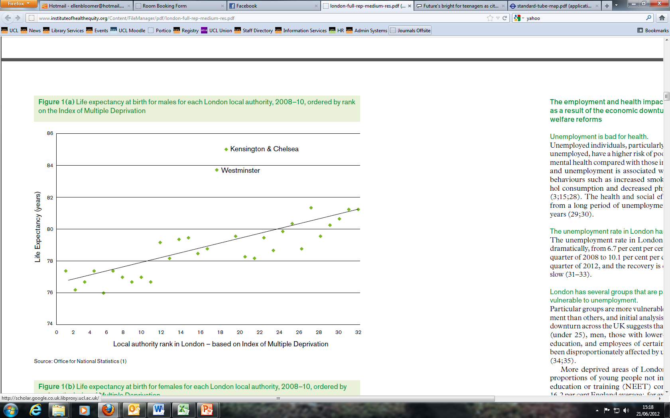

Slide 5
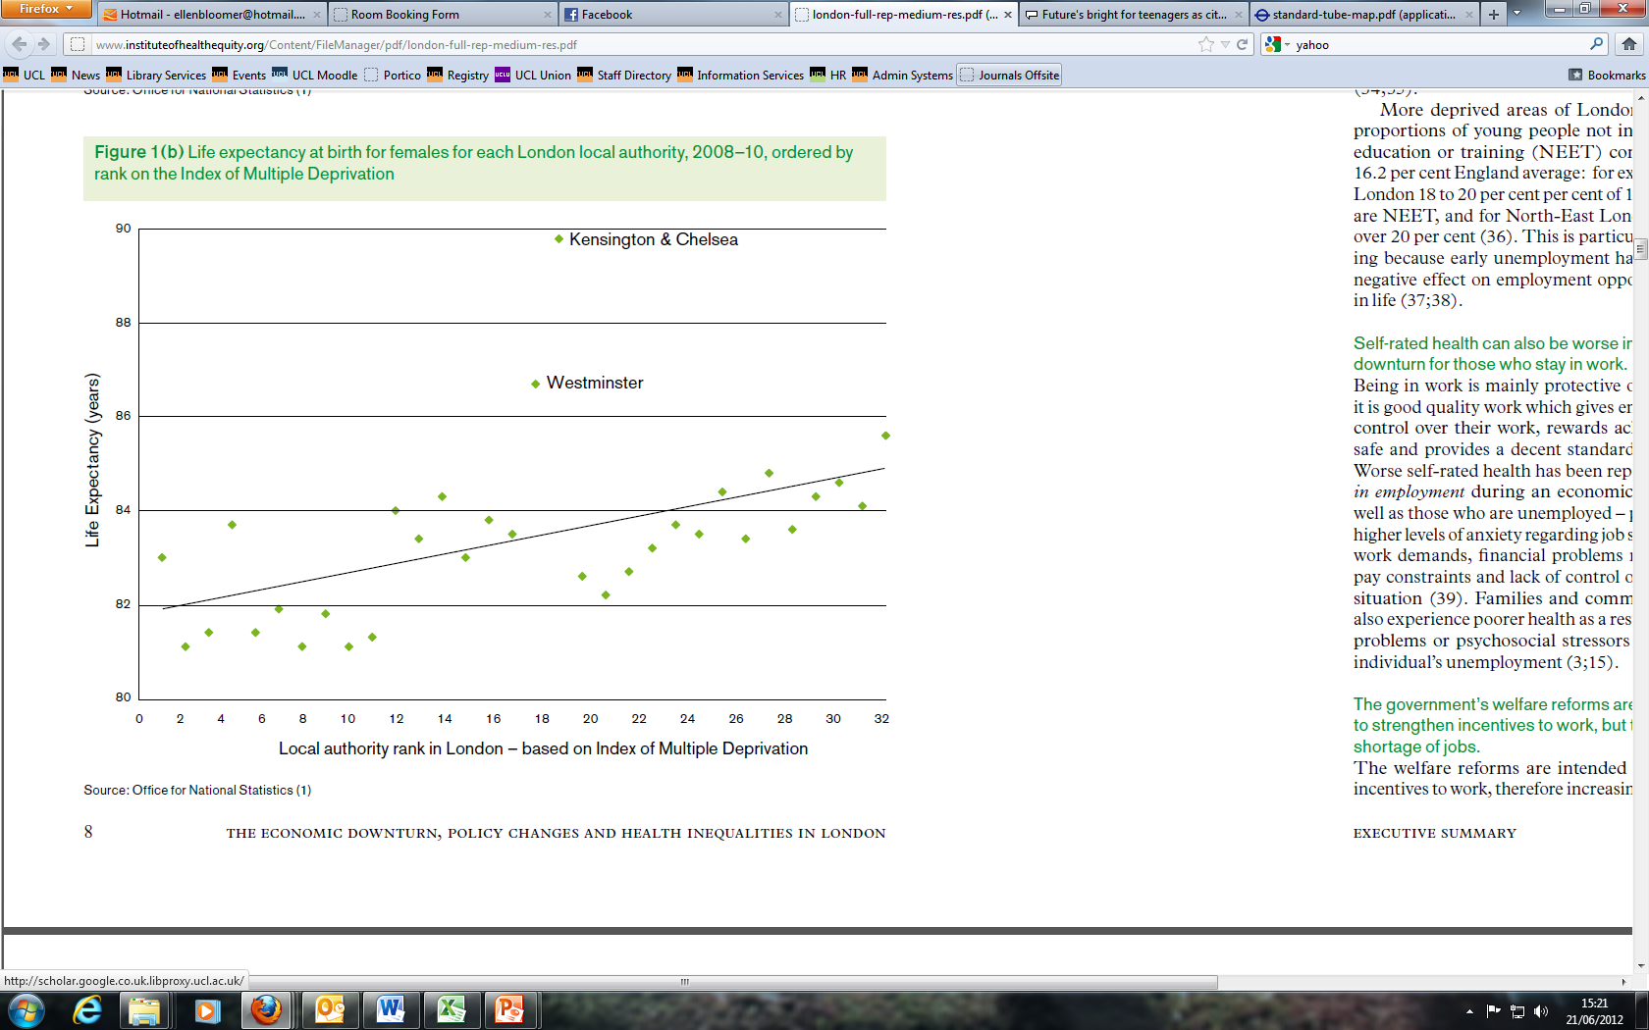

Slide 6
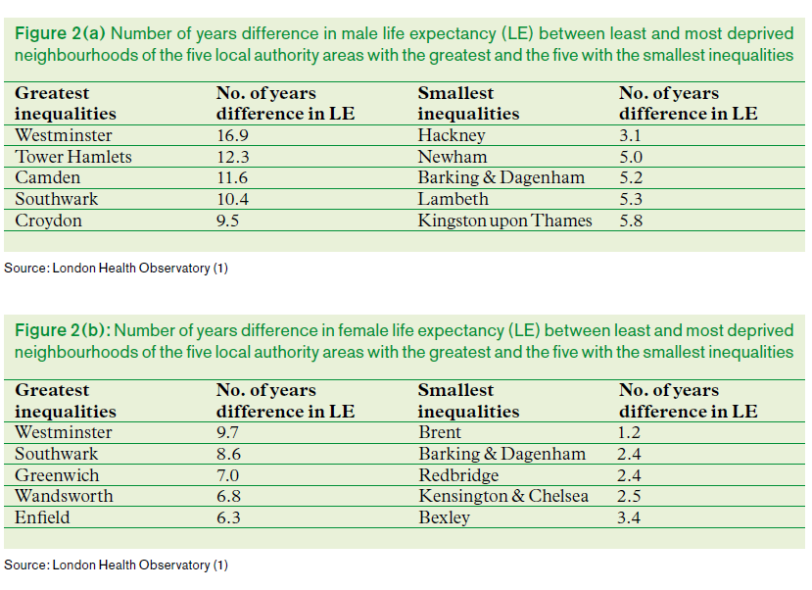

Slide 7
Evidence from previous economic downturns suggests that population health will be affected:
  More suicides and attempted suicides; possibly more homicides and domestic violence
  Fewer road traffic fatalities
  An increase in mental health problems, including depression and possibly lower levels of wellbeing
  Worse infectious disease outcomes such as TB + HIV
  Negative longer-term mortality effects
  Health inequalities are likely to widen

Slide 8
The report specifically looks at the impact of the recession on income, employment and housing:
The economic downturn is causing a rise in unemployment, a fall in income for many households, which in turn may cause housing problems for those who experience lower incomes.
  London unemployment up from 6.7% (Q2 2008) to 10.1% (Q1 2012)
  There is a shortage of affordable homes in London. The number of homeless people and those living in overcrowded homes has risen.
Unemployment, low incomes and poor housing contribute to worse health.
These problems are more likely to occur among particular groups within the population and among those already on low incomes.

Slide 9
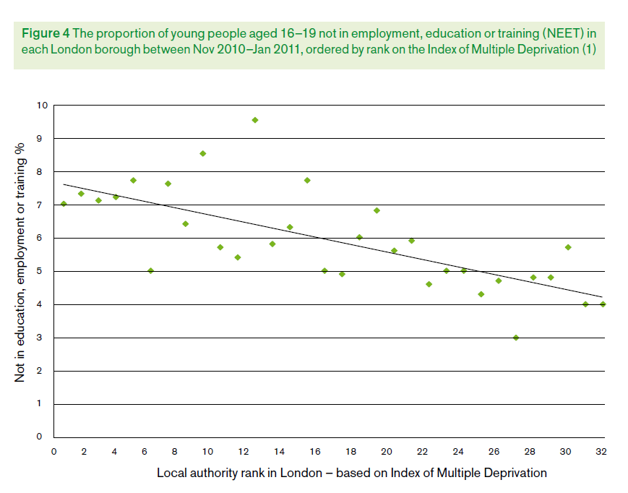

Slide 10
Impact of the welfare reforms
£18 billions welfare savings
Intended to strengthen incentives to work, but there is a shortage of jobs.
Many households face reduced benefits – lower incomes, harder to cover housing costs.
Affects low-income households, in particular:
  Workless households and those in >16 hours/ week low-paid work
  Households with children
  Lone parents, possibly also women in couples
  Larger families
  Some minority ethnic households
  Disabled people who are reassessed as ineligible for the Personal Independence Payment
  Private rented tenants.

Slide 11
  Households unable to afford current accommodation will need to find an alternative solution, e.g.
  Take up paid employment
  Re-negotiate rent
  Rent arrears, leading to repossession or non-renewal of tenancy
  Become homeless
  Become overcrowded
  Compromise on housing conditions
  Move to a less expensive area of the capital or out of London.
London should expect significant migration within and between boroughs as more areas become unaffordable.
Likely widening of socioeconomic health inequalities.

Slide 12
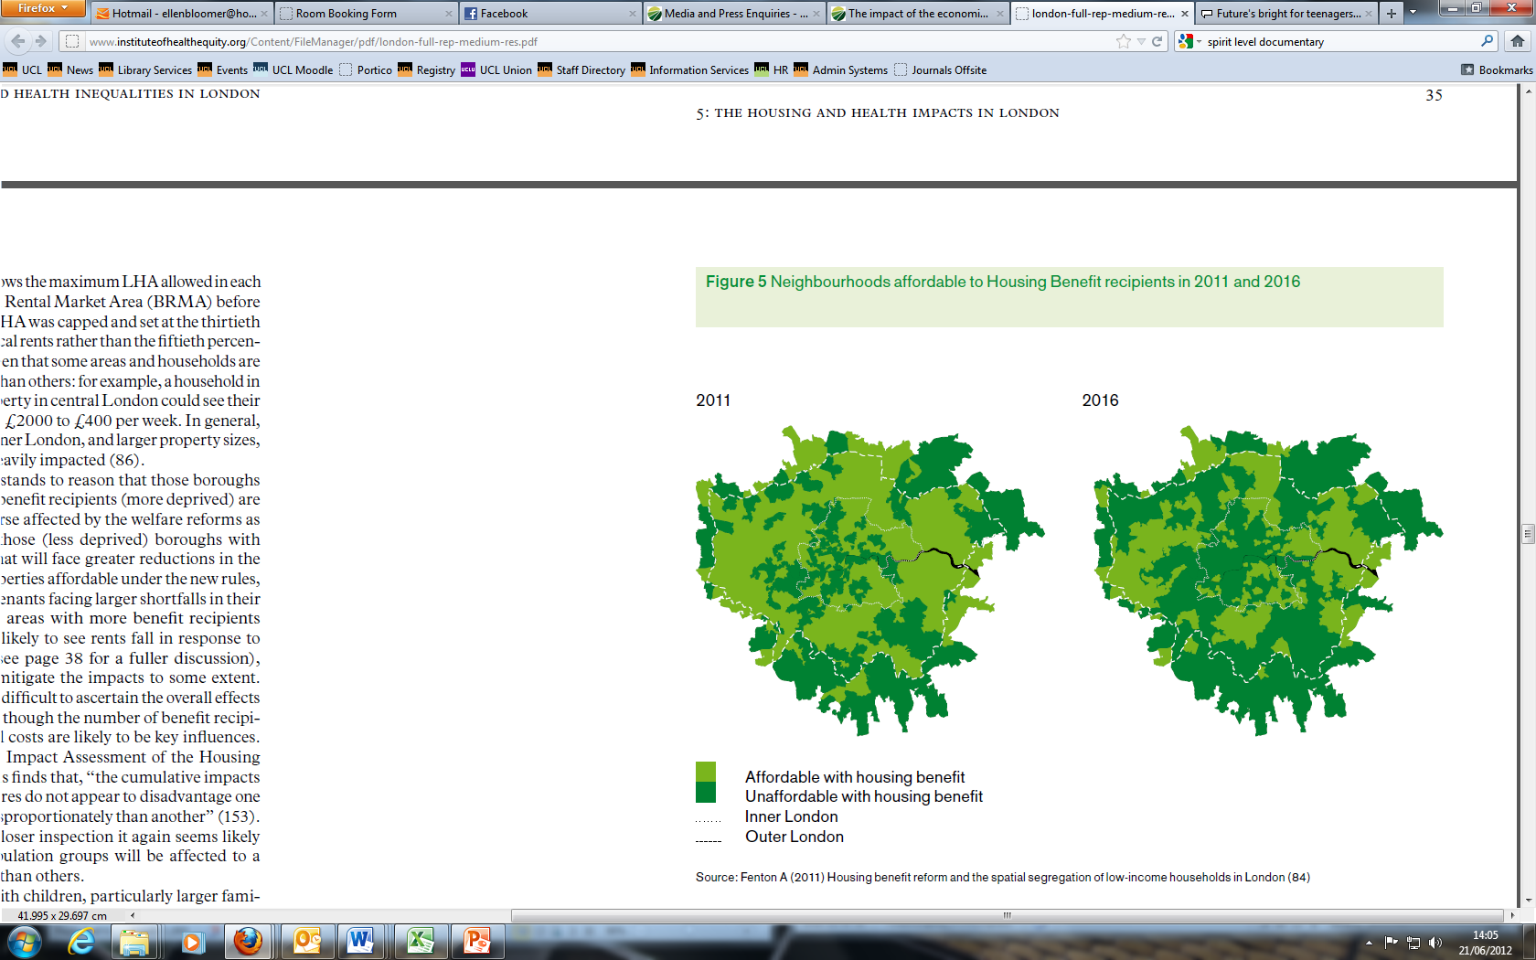

Slide 13
London demographics
London has high numbers of some groups more ‘at risk’ of impacts of welfare reforms:
  Young people
  Minority ethnic and immigrant population
  Lone parents households.
Population growth will put additional pressure on housing and other local resources.

Slide 14
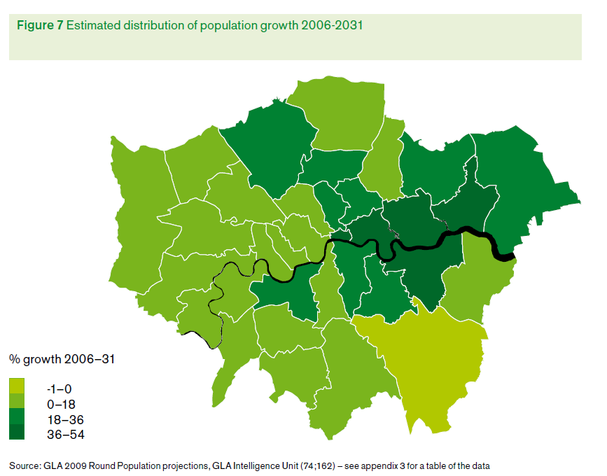

Slide 15
Institute website: www.instituteofhealthequity.org
Full report: http://www.instituteofhealthequity.org/Content/FileManager/pdf/london-full-rep-medium-res.pdf

